Slide 1


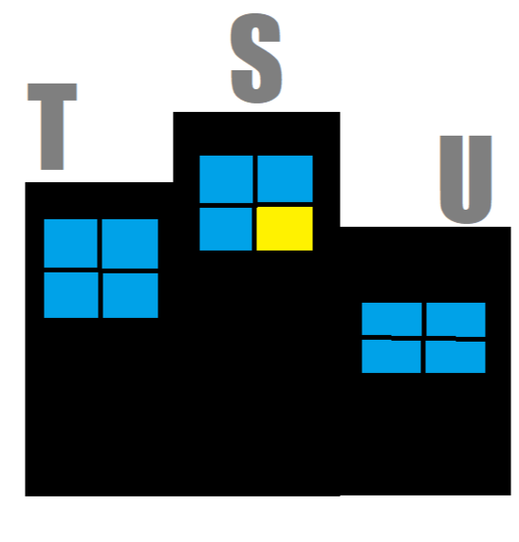

Tri State Urban: Introduction and Background
By Krishna, Piotr, Andy, Anthony, Pranav

Slide 2
Our Goal and Presentation Breakdown
Overall Goal: Find a way to make urban areas more pedestrian friendly
What we will go over:
Who this effects
Problems with the current system
Economic effects of urbanization
Methods of implementation

Slide 3
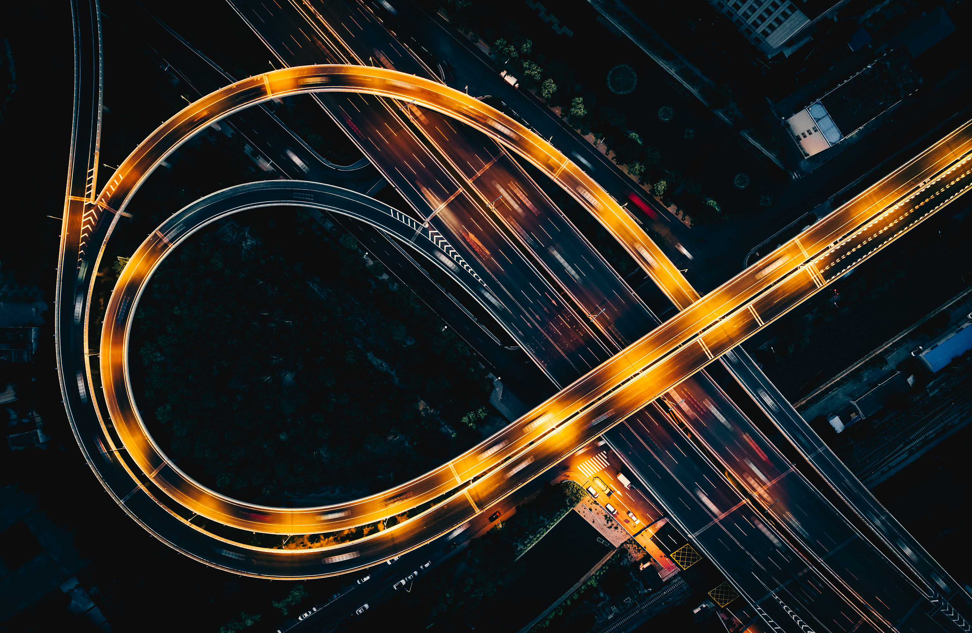
Problems With the Current System
Some options are not eco friendly
Can be expensive
Some places are not within walkable distance or practicality from residential areas
Not time efficient

Slide 4
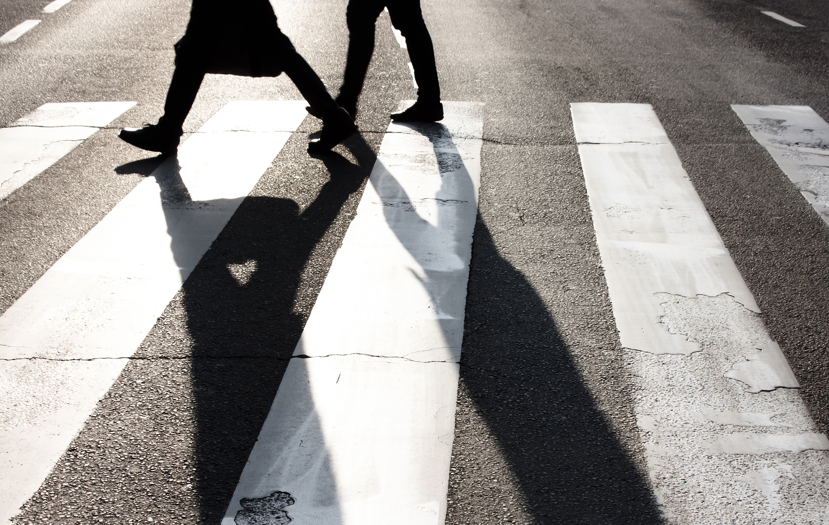


Who This Affects
h

Slide 5
Why Has it Come to This?
Post World War II Urban Model
Generally unhealthy and unsustainable lifestyles
Over reliance on automated and "efficient" transportation as the decades have progressed
The choice of mode of transport is habitual

Slide 6
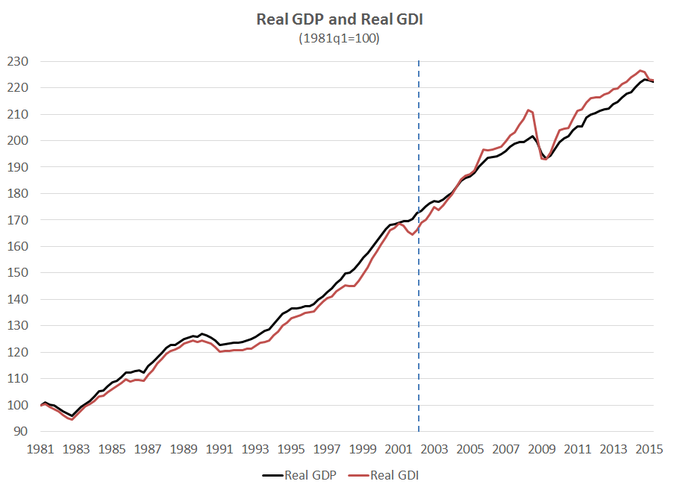
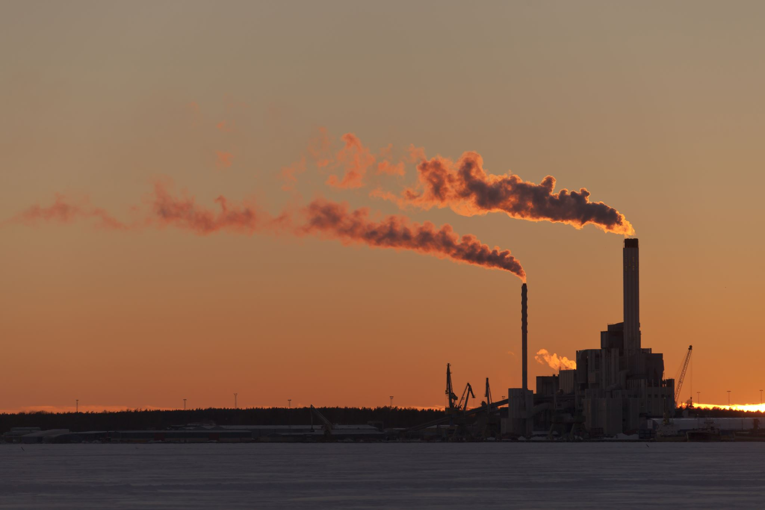
What Urbanization Has Led To
This Photo by Unknown author is licensed under CC BY-ND.

Slide 7
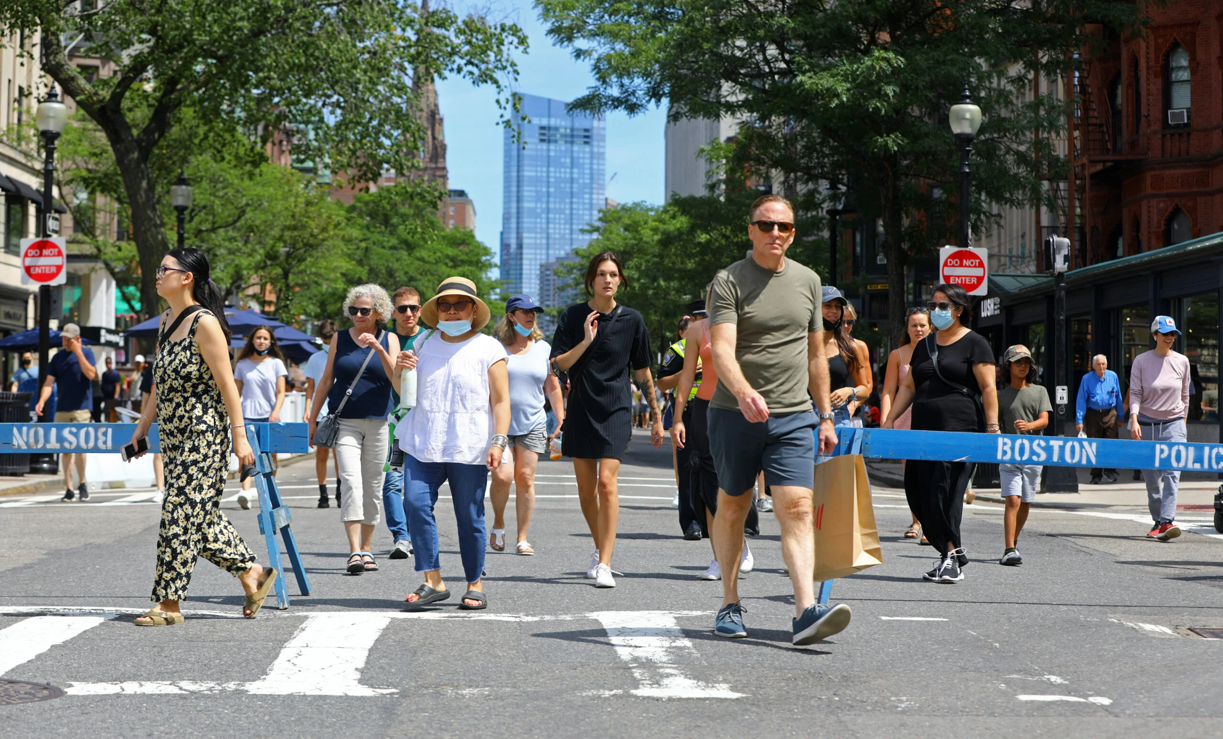
Current Goal and What We Have Found So Far
Current Goal: Conduct research to find the overall publics opinion on this idea and dive deeper into the possible solutions.
What We've Found So Far:
Make bikes more accessible to the public
Build infrastructure where transportation by foot if a practical and safe choice
Pedestrian-only spaces
Educate the public about the benefits of walking
Free-fare transportation

Slide 8
Potential Paths Forward
Professionals who can help
Donald Shoup – UCLA professor, author, has research on economic effects of urbanization
Enrique Penalosa to look at the implementation of pedestrian only zones and specialized sidewalks.
Surveys
Conduct a survey asking questions such as:
What form of transportation do you mostly take when going somewhere that is not within walkable distance?
What are some reasons that you may choose not to bike or walk to your location?

Slide 9
Our Logo
- Different sized buildings
- Singular yellow window

